Slide 1
FIREWALL IN E-COMMERCE
NAME: TALHA MAHMOOD
ROLL No. : 16800116009
CSE, 4th YEAR, 8th SEMESTER
E-COMMERCE

Slide 2
CONTENTS
Introduction
What is Firewall
Applications of Firewall
Software Firewall vs Hardware Firewall
History
Design goals for Firewall

Slide 3
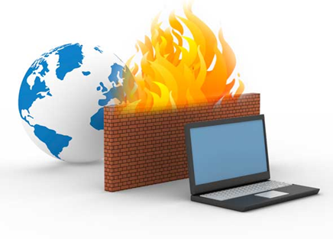
CONTENTS…
Types
Basic concepts of Firewall
Role of Firewall
Advantages
Disadvantages
Conclusion
References

Slide 4
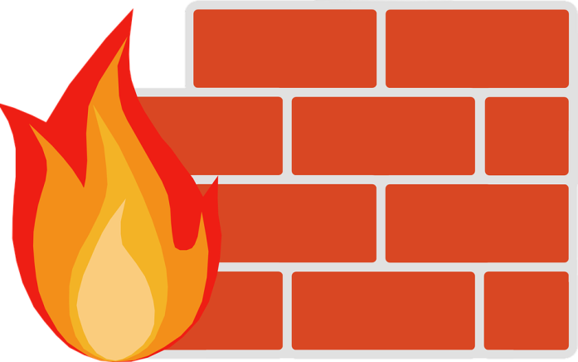
Introduction
The internet has made a large amount of information available to the average computer user at home, in business and education.
For many people, having access to this information is no longer just an advantages; it is essential.
Therefore, security of network is the main criteria here and firewalls provides this security.

Slide 5
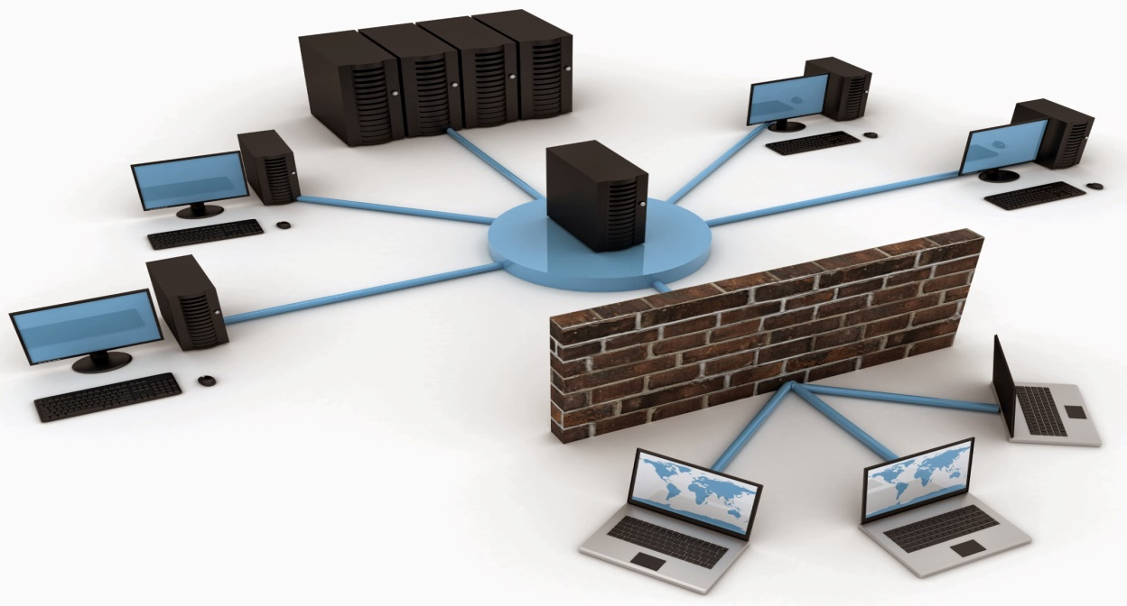
What is Firewall?
A Firewall is simply a program or hardware devices that filters the information coming through the internet connection into your private or computer system.

Slide 6
What is an application firewall?
An application firewall is a special firewall that is specifically coded for the type of traffic it is inspecting.
The most widely developed application firewall is the web application firewall.

Slide 7
What is the difference between a host-based firewall and a network-based firewall?
Host-based firewall
Network-based firewall
A host-based firewall is installed on an individual computer to protect it from activity occurring on its network.
A network-based firewall is implemented at a specified point in the network path and protects all computers on the “internal” side of the firewall from all computers on the “external” side of the firewall.

Slide 8
What is the difference between hardware firewall and a software firewall?
Hardware firewall
Software firewall
Hardware firewalls are integrated into the router that sits between a computer and the Internet.
Software firewalls are installed on individual servers. They intercept each connection request and then determine whether the request is valid or not.

Slide 9
History of Firewalls
Firewall technology first began to emerge in the late 1980s. Internet was still a fairly new technology in terms of its global usage and connectivity.
In 1998 an employee at the NASA Ames Research Center in California sent a memo by email to his colleagues that read, “We are currently under attack from an Internet VIRUS!”
One of the largest internet security companies in the world released the product to the public to the public in 1997.

Slide 10
Design goals for a firewall
The first design goal for a firewall is that collectively the sum of all the network traffic from internal to external must go through the firewall physically cutting off access to the local network except via the firewall.
The second design goal would be only authorized traffic is delineated by the local security policy will be allowed to proceed.
Finally the last design goal is that the firewall itself is resistant to penetration inclusive is a solid trustworthy system with a protected operated operating system.

Slide 11
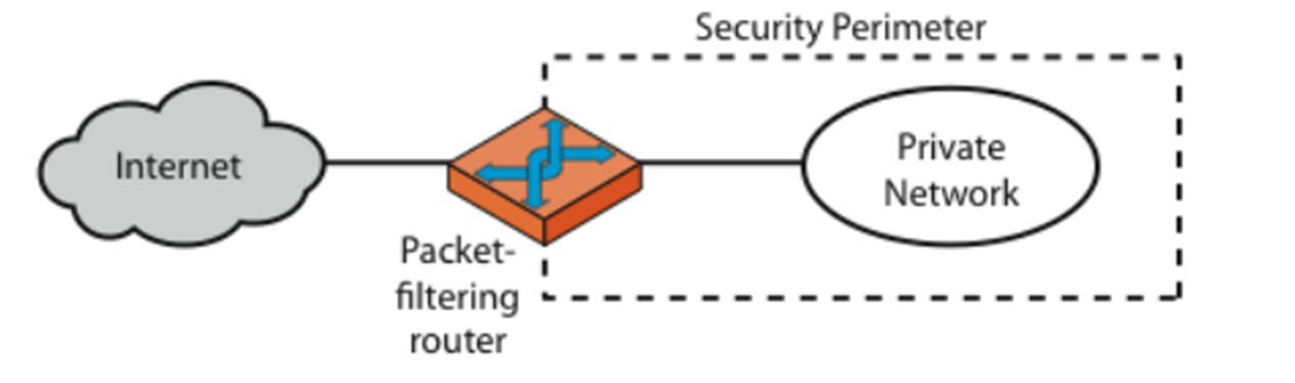
Types of firewalls
Packet-filtering Router

Slide 12
Packet-filtering Router
Applies a set of rules to each incoming IP packet and then forwards or discards the packet.
Filter packets going to both directions.
The packet filter is typically set up as a list of rules based on matches to fields in the IP or TCP header.
Two default policies (discard or forward).

Slide 13
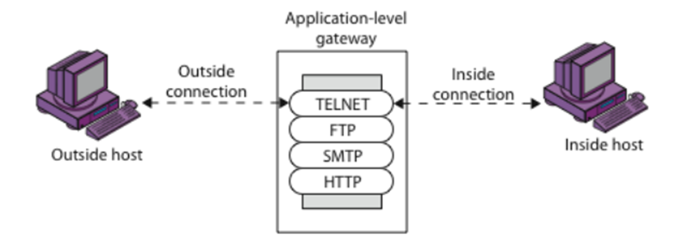
Types of firewalls...
Application-Level Gateway

Slide 14
Application-level Gateway
Also called proxy server
Acts as a relay of application-level traffic

Slide 15
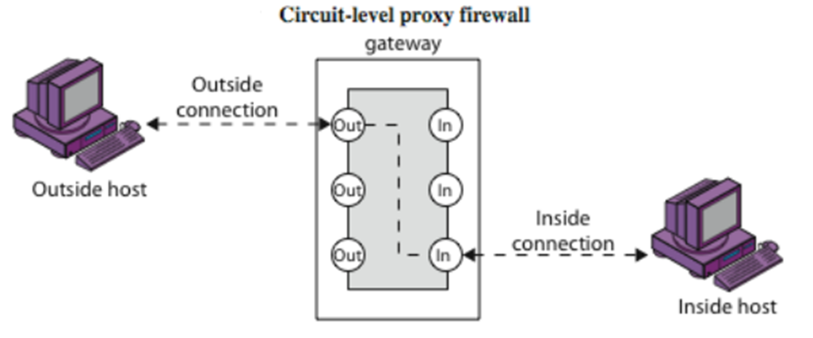
Types of firewalls...
Circuit-Level Gateway

Slide 16
Circuit-level Gateway
Stand-alone system or
Specialized function performed by an Application-level Gateway
Sets up two TCP connections
The gateway typically relays TCP segments from one connection to the other without examining the contents
The security function consists of determining which connection will be allowed

Slide 17
Basic concepts of a firewall
Source
Destination
Service
Action

Slide 18
The Role of Firewalls
A firewall is a term used for a “barrier” between a network of machines and users that operate under a common security policy and generally trust each other, and the outside world.
There are two basic reason for using a firewall at present: to save money in concentrating your security on a small number of components, and to simplify the architecture of a system by restricting access only to machines that trust each other.

Slide 19
Advantages of firewall
Concentration of security all modified software and logging is located on the firewall system as opposed to being distributed on many host;
Protocol filtering, where the firewall filters protocols and services that are either nor necessary or that cannot be adequately secured from exploitation;
Information hiding, in which a firewall can “hide” names of internal systems or e-mail addresses, thereby revealing less information to outside hosts;
Application gateways, where the firewall requires inside or outside users to connect first to the firewall before connecting further, thereby filtering the protocol;

Slide 20
Disadvantages of firewall
The most obvious being that certain types of network access may be hampered or even blocked for some hosts, including telnet, FTP, Windows X, NFS, NIS, etc.
A second disadvantages with a firewall system is that it concentrates security in one spot as opposed to distributing it among systems, thus a compromise of the firewall could be disastrous to other less- protected systems on the subnet.

Slide 21
Conclusion
One of the best thing about a firewall from a security standpoint is that it stops anyone on the outside from logging onto a computer in our private network.
While this is a deal for business, most home networks will probably not be threatened in this manner. Still, putting a firewall in place provide some peace of mind.

Slide 22
References
www.wikipedia.com
https://www.cse.wustl.edu/~jain/cse571-17/ftp/l_23fw.pdf
www.google.com

Slide 23
Thanks!!!!

